Slide 1
Lesson 2
Database Concepts

Slide 2
In this chapter, you will learn:
The difference between data and information
What a database is, about different types of databases, and why they are valuable assets for decision making
Why database design is important
How modern databases evolved from files and file systems
Database Systems: Design, Implementation, & Management, 6th Edition, Rob & Coronel

Slide 3
In this chapter, you will learn (continued):
About flaws in file system data management
Duplication of data
Program-data dependence
Excessive program maintenance
Limited data sharing
How a database system differs from a file system, and how a DBMS functions within the database system
About data storage and retrieval strategies
Database Systems: Design, Implementation, & Management, 6th Edition, Rob & Coronel

Slide 4
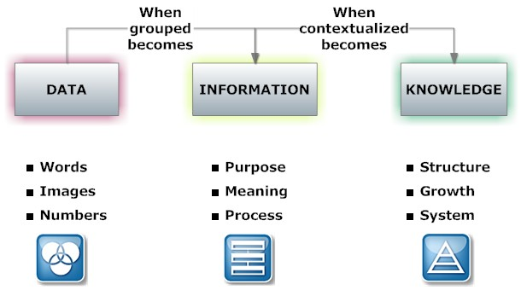
Data vs. Information
Data:
  Raw facts; building blocks of information
  Unprocessed information
Information:
  Data processed to reveal meaning
Accurate, relevant, and timely information is key to good decision making
Good decision making is key to survival in global environment

Slide 5
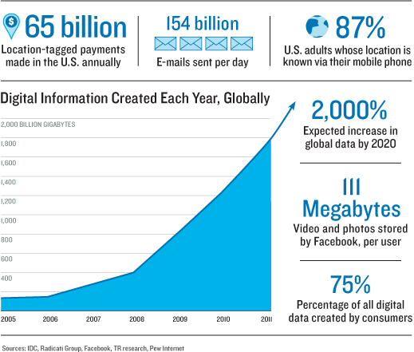
Meaningful Information - example

Slide 6
Data Management Trends
Computer
File-based
System
Paper
File-based
Database
Data Warehouse
And
Datamining
Read:
http://cnx.org/content/m28156/latest/
Sighted 09/05/2014

Slide 7
What are Databases and _x000b_Why do we need them?

Slide 8
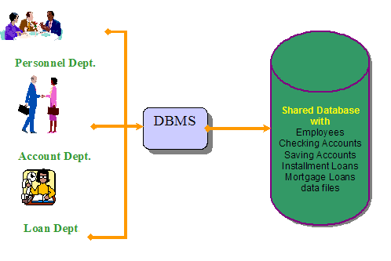
Database Approach
Database—shared, integrated computer structure that houses:
  End user data (raw facts)
  Metadata (data about data)
Database Systems: Design, Implementation, & Management, 6th Edition, Rob & Coronel

Slide 9
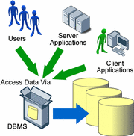
Database Approach
DBMS (database management system):
  Collection of programs that manages database structure and controls access to data
  Possible to share data among multiple applications or users
  Makes data management more efficient and effective
Database Systems: Design, Implementation, & Management, 6th Edition, Rob & Coronel

Slide 10
DBMS Makes Data Management More Efficient and Effective
End users have better access to more and better-managed data
  Promotes integrated view of organization’s operations
    Better understanding and minimize errors VS individualistic view (the story of the 4 blind man describing an elephant)
  Probability of data inconsistency is greatly reduced
  Possible to produce quick answers to ad hoc queries
Database Systems: Design, Implementation, & Management, 6th Edition, Rob & Coronel

Slide 11
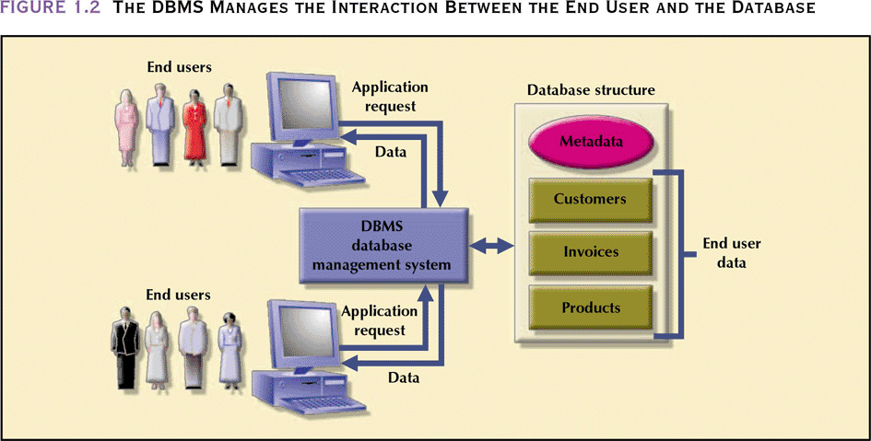
The DBMS Manages the Interaction Between the End User and the Database
Database Systems: Design, Implementation, & Management, 6th Edition, Rob & Coronel

Slide 12
Types of Databases
Single-user:
  Supports only one user at a time
Desktop:
  Single-user database running on a personal computer
Multi-user:
  Supports multiple users at the same time
Database Systems: Design, Implementation, & Management, 6th Edition, Rob & Coronel

Slide 13
Types of Databases (continued)
Workgroup:
  Multi-user database that supports a small group of users or a single department
Enterprise:
  Multi-user database that supports a large group of users or an entire organization
Database Systems: Design, Implementation, & Management, 6th Edition, Rob & Coronel

Slide 14
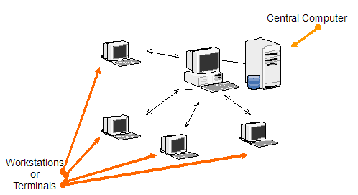
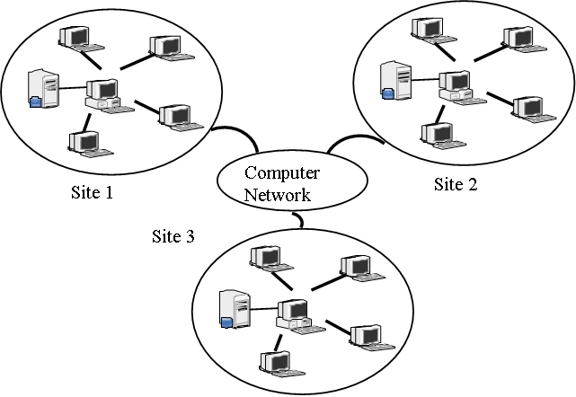
Location of Databases
Centralized:
  Supports data located
Distributed:
  Supports data distributed across several site

Slide 15
Uses of Databases
Transactional (or production):
  Supports a company’s day-to-day operations
Data warehouse:
  Stores data used to generate information required to make tactical or strategic decisions
    Such decisions typically require “data massaging”
  Often used to store historical data
Database Systems: Design, Implementation, & Management, 6th Edition, Rob & Coronel

Slide 16
Why Database Design is Important
Defines the database’s expected use
Different approach needed for different types of databases
Avoid redundant data (unnecessarily duplicated)
Poorly designed database generates errors → leads to bad decisions → can lead to failure of organization
Database Systems: Design, Implementation, & Management, 6th Edition, Rob & Coronel

Slide 17
Manual File Systems
Traditionally composed of collection of file folders kept in file cabinet
Organization within folders was based on data’s expected use (ideally logically related)
System was adequate for small amounts of data with few reporting requirements
Finding and using data in growing collections of file folders became time-consuming and cumbersome
Database Systems: Design, Implementation, & Management, 6th Edition, Rob & Coronel

Slide 18
Conversion from Manual File System to Computer File System
Could be technically complex, requiring hiring of data processing (DP) specialists
DP specialists created file structures, wrote software, and designed application programs
Resulted in numerous “home-grown” systems being created
Initially, computer files were similar in design to manual files
Database Systems: Design, Implementation, & Management, 6th Edition, Rob & Coronel

Slide 19
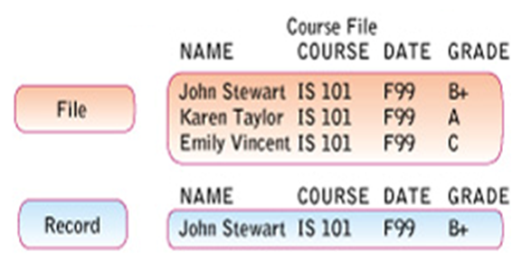


Components of a File
character
J, n S w

Slide 20
Example of Early Database Design
DP specialist wrote programs for reports:
  Monthly summaries of types and amounts of insurance sold by agents
  Monthly reports about which customers should be contacted for renewal
  Reports that analyzed ratios of insurance types sold by agent
  Customer contact letters summarizing coverage
Additional reports were written as required
Database Systems: Design, Implementation, & Management, 6th Edition, Rob & Coronel

Slide 21
Example of Early Database Design (continued)
Other departments requested databases be written for them
  SALES database created for sales department
  AGENT database created for personnel department
Database Systems: Design, Implementation, & Management, 6th Edition, Rob & Coronel

Slide 22
Evolution of Simple File System
As number of databases increased, small file system evolved
Each file used its own application programs
Each file was owned by individual or department who commissioned its creation
Database Systems: Design, Implementation, & Management, 6th Edition, Rob & Coronel

Slide 23
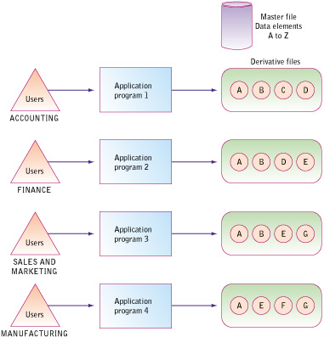
File-based System
Each of the files in the systems used its own application programs to store, retrieve and modify data
Each file was owned by the department that created it.

Slide 24
Problems with
File System Data Management
Every task requires extensive programming in a third-generation language (3GL)
  Programmer must specify task and how it must be done
Modern databases use fourth-generation language (4GL)
  Allows user to specify what must be done without specifying how it is to be done
Database Systems: Design, Implementation, & Management, 6th Edition, Rob & Coronel

Slide 25
Programming in 3GL
Time-consuming, high-level activity
Programmer must be familiar with physical file structure
As system becomes complex, access paths become difficult to manage and tend to produce malfunctions
Complex coding establishes precise location of files and system components and data characteristics
Database Systems: Design, Implementation, & Management, 6th Edition, Rob & Coronel

Slide 26
Programming in 3GL (continued)
Ad hoc queries are impossible
Writing programs to design new reports is time consuming
As number of files increases, system administration becomes difficult
Making changes in existing file structure is difficult
File structure changes require modifications in all programs that use data in that file
Modifications are likely to produce errors, requiring additional time to “debug” the program
Security features hard to program and therefore often omitted
Database Systems: Design, Implementation, & Management, 6th Edition, Rob & Coronel

Slide 27
Structural and Data Dependence
Structural dependence
  Access to a file depends on its structure
Data dependence
  Changes in database structure affect program’s ability to access data
  Logical data format
    How a human being views the data
  Physical data format
    How the computer “sees” the data
Database Systems: Design, Implementation, & Management, 6th Edition, Rob & Coronel

Slide 28
Data Redundancy
Data redundancy results in data inconsistency
  Different and conflicting versions of the same data appear in different places
Errors more likely to occur when complex entries are made in several different files and recur frequently in one or more files
Data anomalies develop when required changes in redundant data are not made successfully
Database Systems: Design, Implementation, & Management, 6th Edition, Rob & Coronel

Slide 29
Data Anomalies
Unable to perform certain data maintenance due to errors in database design
Modification anomalies
  Occur when changes must be made to existing records
Insertion anomalies
  Occur when entering new records
Deletion anomalies
  Occur when deleting records
Database Systems: Design, Implementation, & Management, 6th Edition, Rob & Coronel

Slide 30
Database vs. File System
Problems inherent in file systems make using a database system desirable
File system
  Many separate and unrelated files
Database
  Logically related data stored in a single logical data repository
Database Systems: Design, Implementation, & Management, 6th Edition, Rob & Coronel

Slide 31
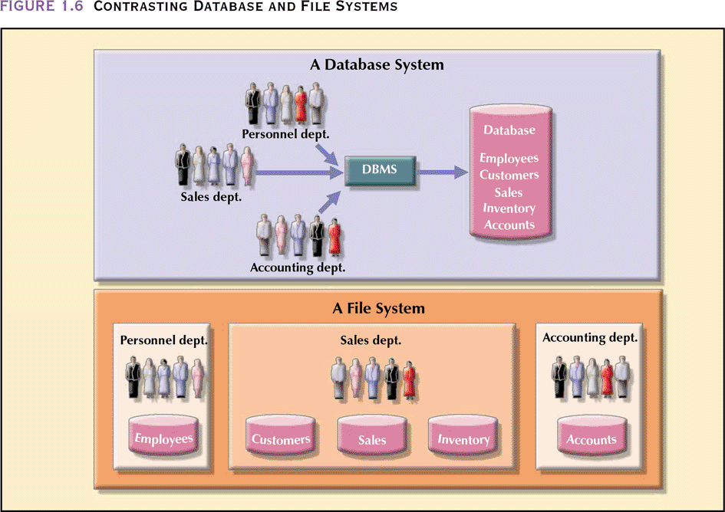
Contrasting Database and File Systems
Database Systems: Design, Implementation, & Management, 6th Edition, Rob & Coronel

Slide 32
The Database System Environment
Database system is composed of 5 main parts:
  Hardware
  Software
    Operating system software
    DBMS software
    Application programs and utility software
  People
  Procedures
  Data
Database Systems: Design, Implementation, & Management, 6th Edition, Rob & Coronel

Slide 33
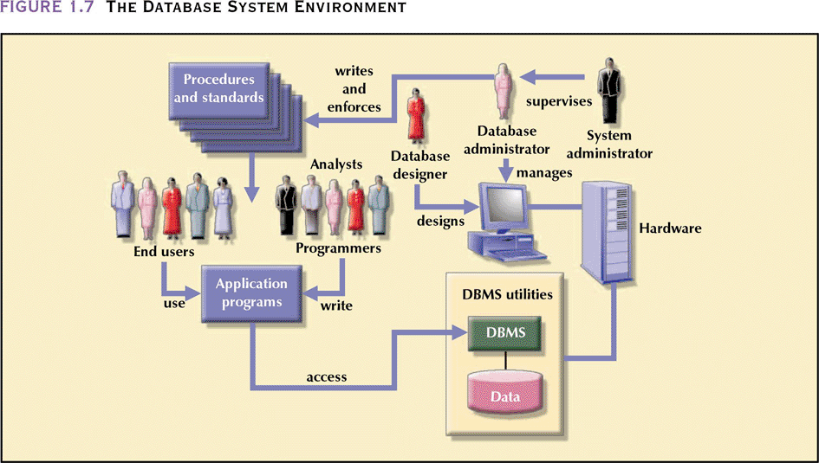
The Database System Environment (continued)
Database Systems: Design, Implementation, & Management, 6th Edition, Rob & Coronel

Slide 34
DBMS Functions
Performs functions that guarantee integrity and consistency of data
  Data dictionary management
    defines data elements and their relationships
  Data storage management
    stores data and related data entry forms, report definitions, etc.
  Data transformation and presentation
    translates logical requests into commands to physically locate and retrieve the requested data
Database Systems: Design, Implementation, & Management, 6th Edition, Rob & Coronel

Slide 35
DBMS Functions (continued)
  Security management
    enforces user security and data privacy within database
  Multi-user access control
    creates structures that allow multiple users to access the data
  Backup and recovery management
    provides backup and data recovery procedures
Database Systems: Design, Implementation, & Management, 6th Edition, Rob & Coronel

Slide 36
DBMS Functions (continued)
  Data integrity management
    promotes and enforces integrity rules to eliminate data integrity problems
  Database access languages and application programming interfaces
    provides data access through a query language
  Database communication interfaces
    allows database to accept end-user requests within a computer network environment
Database Systems: Design, Implementation, & Management, 6th Edition, Rob & Coronel

Slide 37
Summary
Information is derived from data, which is stored in a database
To implement and manage a database, use a DBMS
Database design defines its structure
Good design is important
Database Systems: Design, Implementation, & Management, 6th Edition, Rob & Coronel

Slide 38
Summary (continued)
Databases were preceded by file systems
Because file systems lack a DBMS, file management becomes difficult as a file system grows
DBMS were developed to address file systems’ inherent weaknesses
Database Systems: Design, Implementation, & Management, 6th Edition, Rob & Coronel

Slide 39
Physical data storage concepts
Homework – Reading Assignment
What are the media and devices?
How does it actually work?
What are the most common operations on files?
Typical files storage methods and its uses
How to make access to data faster?
How to make storage of data more permanent?
Indexing files to facilitate faster records access
Reference: Fundamentals of Database Systems, 6th Ed, Elmasri, Navathe - chapters 17,18

Slide 40
Physical data storage concepts
Disk Storage Devices
Files of Records
Operations on Files
Unordered Files
Ordered Files
Hashed Files
  Dynamic and Extendible Hashing Techniques
RAID Technology
Indexed File
Reference: Fundamentals of Database Systems, 6th Ed, Elmasri, Navathe - chapters 17,18

Slide 41
Operation on Files
Typical file operations include:
  OPEN: Readies the file for access, and associates a pointer that will refer to a current file record at each point in time.
  FIND: Searches for the first file record that satisfies a certain condition, and makes it the current file record.
  FINDNEXT: Searches for the next file record (from the current record) that satisfies a certain condition, and makes it the current file record.
  READ: Reads the current file record into a program variable.
  INSERT: Inserts a new record into the file & makes it the current file record.
  DELETE: Removes the current file record from the file, usually by marking the record to indicate that it is no longer valid.
  MODIFY: Changes the values of some fields of the current file record.
  CLOSE: Terminates access to the file.
  REORGANIZE: Reorganizes the file records.
    For example, the records marked deleted are physically removed from the file or a new organization of the file records is created.
  READ_ORDERED: Read the file blocks in order of a specific field of the file.

